Slide 1


TIME SERIES
ANALYSIS & FORCASTING
Predicting Bengaluru’s Future: NDVI, Rainfall, AQI, Temperature Trends for a Sustainable Tomorrow!
TEAM - DEEPESH YADAV
VENKAT

Slide 2
PROJECT OVERVIEW
Objective
To analyze the relationship between urbanization, vegetation health (NDVI), air quality (AQI), Rainfall and Temperature in Bengaluru, Chennai.
To develop a predictive model using satellite data (Sentinel-2, Sentinel-5P, MODIS, ERA5) to forecast AQI, NDVI, Rainfall and Temperature in the coming years, thereby supporting sustainability efforts in urban planning and policymaking.

Slide 3

Time Series Overview
What is Time Series Forecasting?
Time series forecasting is a technique used to predict future values based on previously observed data points collected over time. It involves identifying patterns such as trends, seasonality, and cyclical behaviors to make informed predictions.
A time series consists of:
Trend: Long-term movement in data.
Seasonality: Repeating patterns at regular intervals.
Cyclic Patterns: Irregular fluctuations that are not tied to seasonality.
Noise: Random variations with no predictable pattern.

Slide 4
Data Collection & Preprocessing
Data Overview :
Multi-Source Satellite Data
NDVI (Vegetation Health): Landsat 8
Temperature & Rainfall: ERA5-Land, CHIRPS
Air Quality (NO₂ & Aerosol Index): Sentinel-5P
Temporal Structure
Time-series data with daily/monthly timestamps
Enables trend analysis and forecasting
Spatial Structure
Data extracted for a defined geographical region (e.g., city + 10 km buffer)
Final Data Format (Tabular)
Columns: Date, NDVI, Temperature, Rainfall, NO₂, Aerosol Index
Suitable for EDA, visualization, and predictive modeling

Slide 5
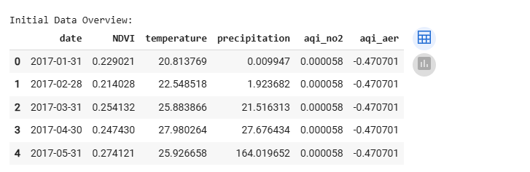
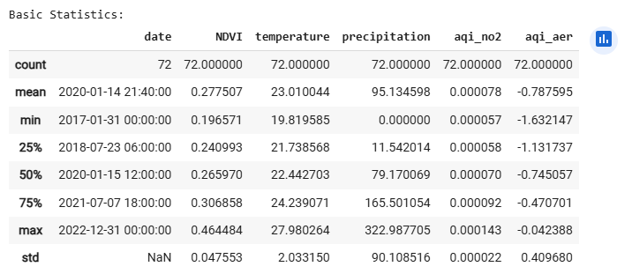
Data Collection & Preprocessing
Data Overview :

Slide 6
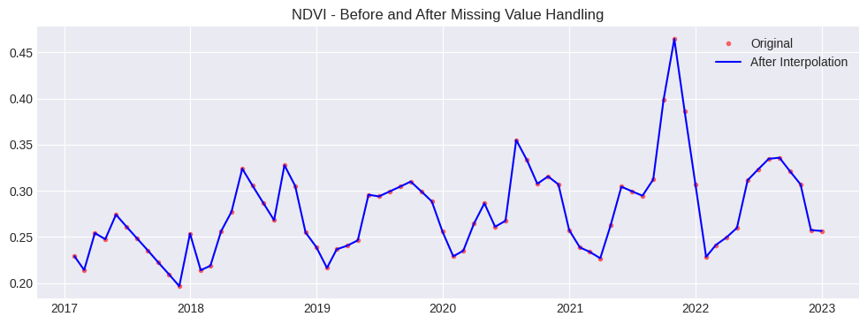
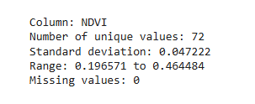
Data Cleaning & Preprocessing:
Handling Missing Values
Linear Interpolation used to fill gaps in NDVI, Temperature, Rainfall, NO₂, and Aerosol Index
Plots:

Slide 7
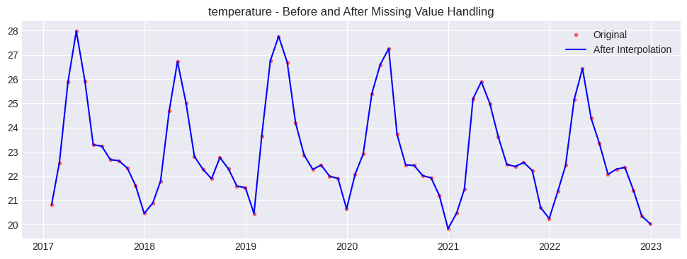
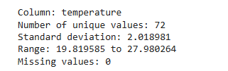
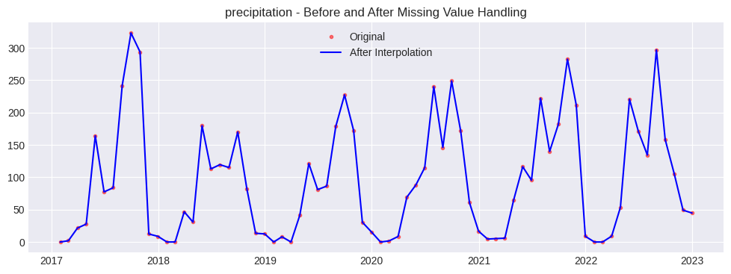
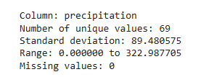
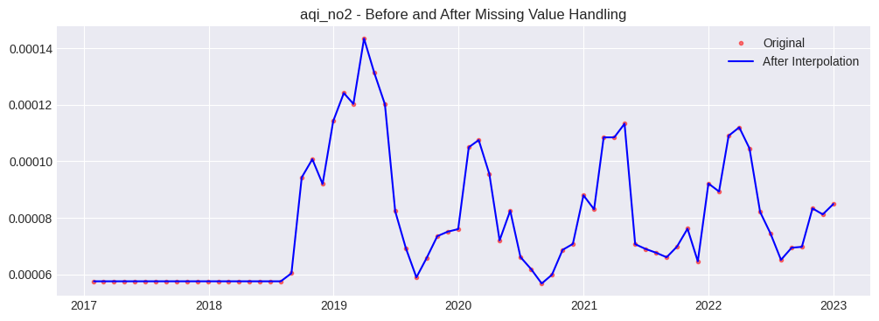
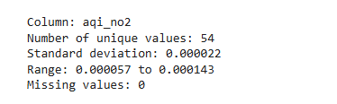

Slide 8
Data Cleaning & Preprocessing: (Removing Outliers)
Z-Score Method
Detects outliers using standard deviation from the mean.
Values beyond a threshold of 3 standard deviations are considered outliers.
Handling Low-Variation Columns
If a column has very low standard deviation, outlier removal is skipped to avoid data distortion.
Replacement & Interpolation
Outliers are marked as NaN and filled using linear interpolation to maintain continuity.
Diagnostic Visualization
Before & After Scatter Plots are used to confirm effective outlier removal.

Slide 9
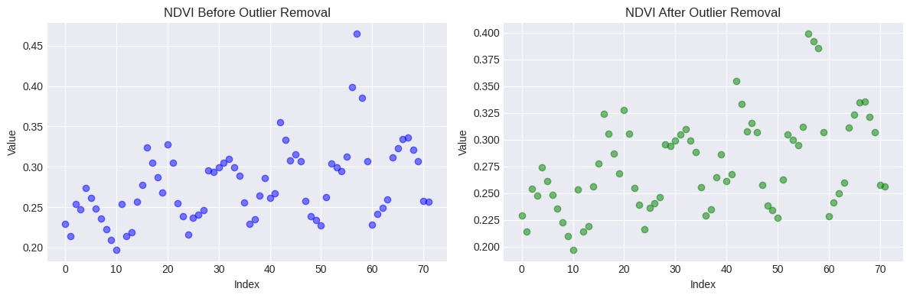
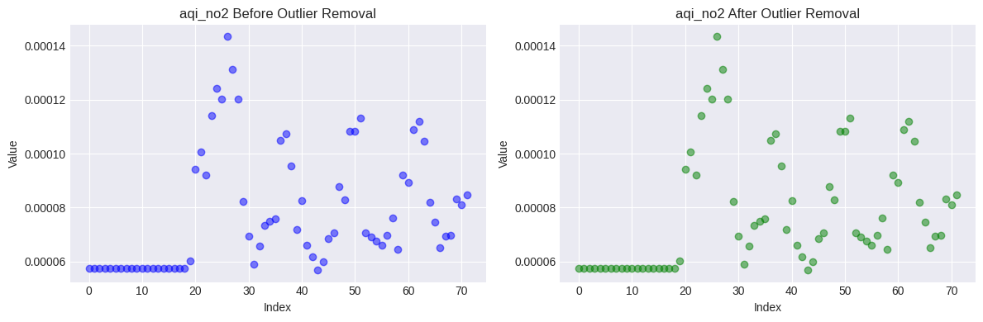
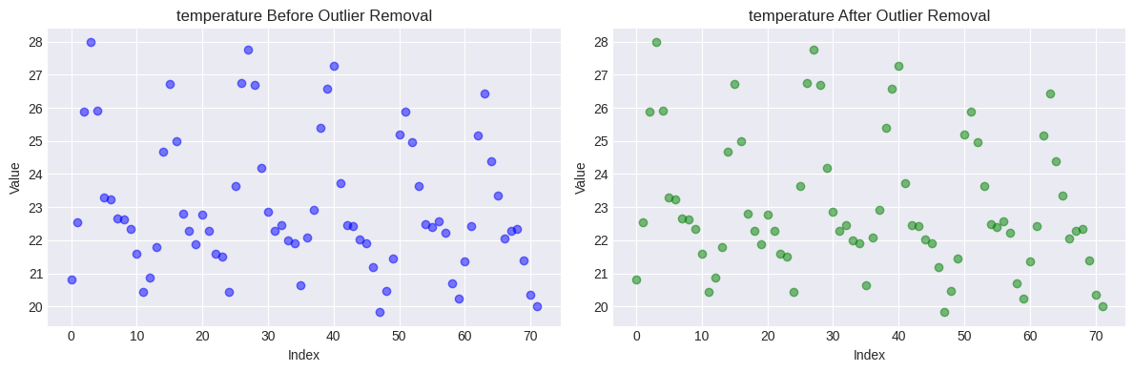
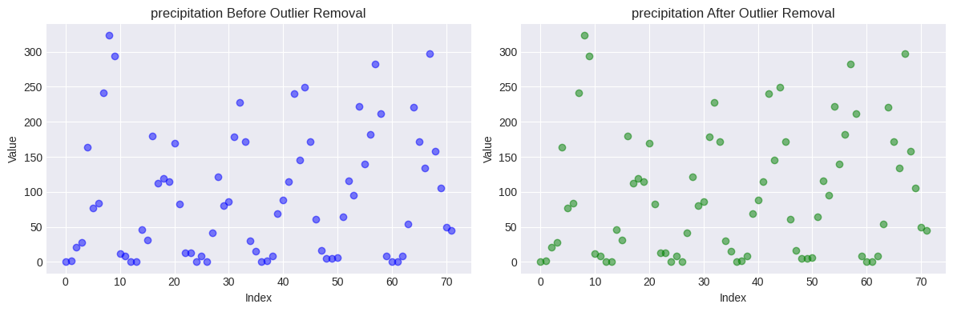
Visualizations:

Slide 10
Data Cleaning & Preprocessing: (Data Smoothing)
Rolling Mean (Moving Average)
Applied to smooth fluctuations and reveal trends
Helps reduce short-term variations in NDVI, Temperature, Rainfall, NO₂, and Aerosol Index
Savitzky-Golay Filter
A polynomial smoothing technique preserving trends
Reduces noise while maintaining data structure
Seasonal Trend Decomposition
Uses rolling statistics to extract long-term trends
Helps in understanding seasonality effects

Slide 11
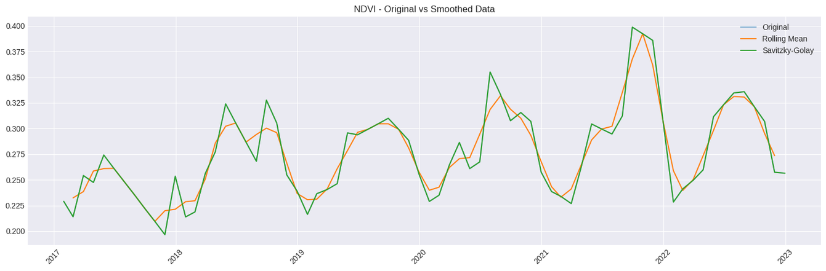
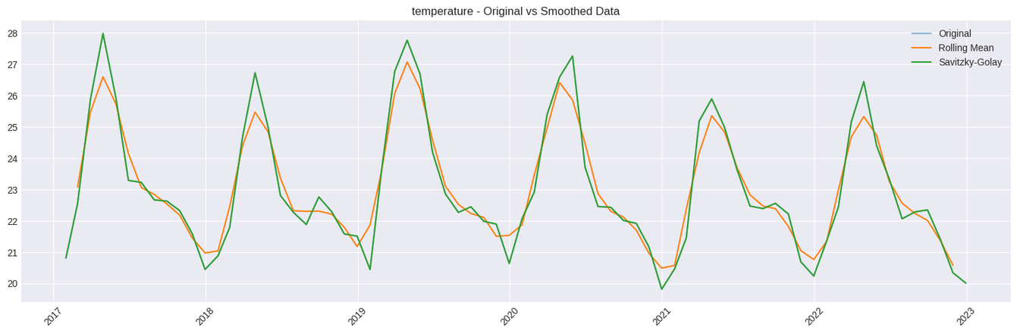
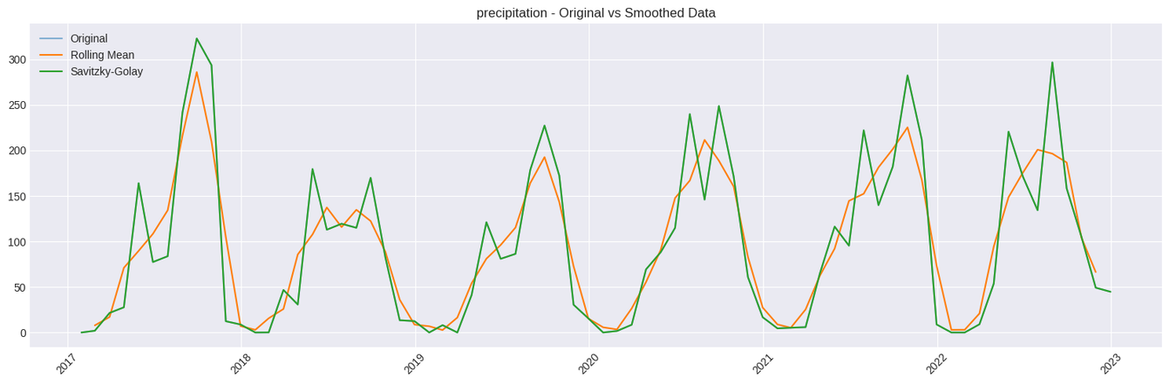
Visualizations:

Slide 12
Exploratory Data Analysis (EDA)
Trend Analysis:
Rolling Mean (Moving Average): Applied to smooth short-term fluctuations.
Trend Extraction: Using a centered rolling window to highlight long-term patterns.
Detrending: Removing the trend component to analyze residual variations.
Seasonality Analysis:
Seasonal Decomposition: Uses seasonal_decompose to separate trend, seasonal, and residual components.
Monthly Mean Centering: Identifies repeating seasonal patterns by calculating monthly averages.

Slide 13
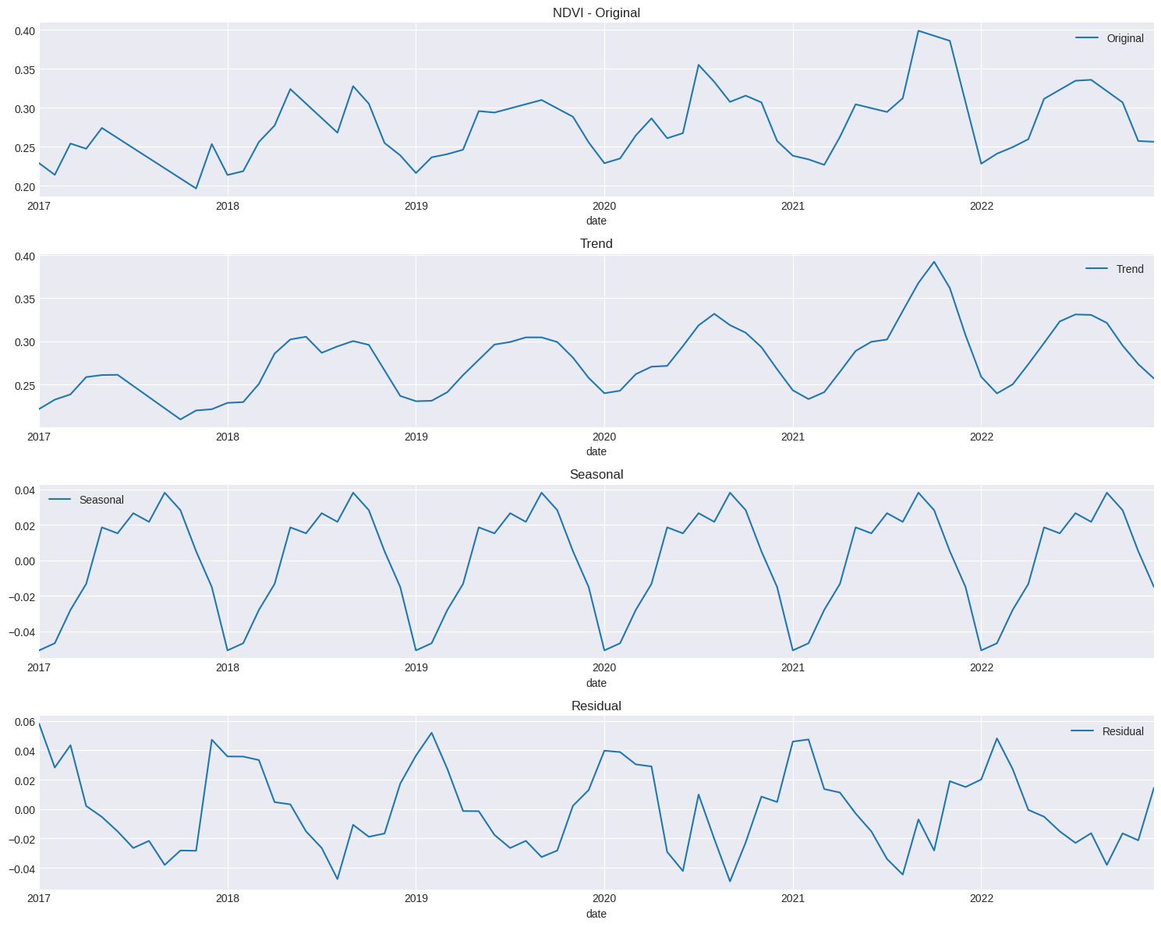
Trend & Seasonality Analysis :
(NDVI) -->
Trend Component (long-term movement)
Seasonal Component (recurring patterns)
Residual Component (random noise)

Slide 14
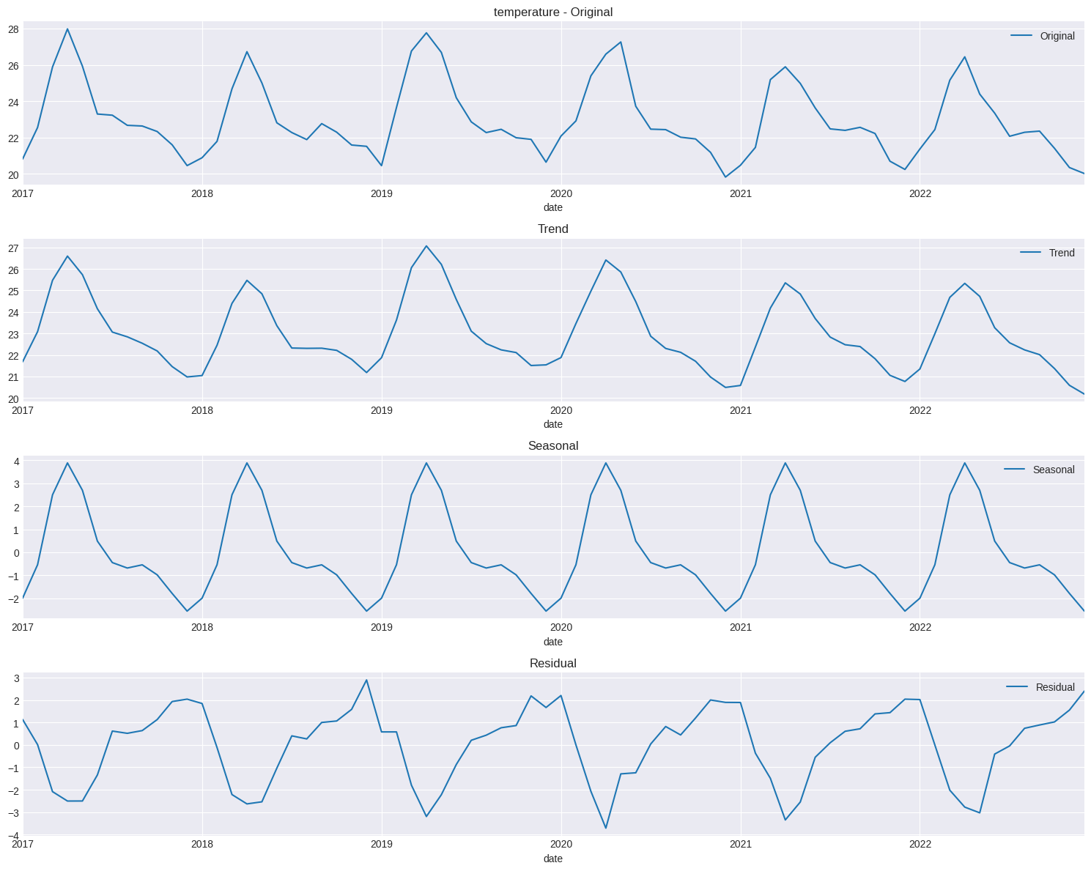
Trend & Seasonality Analysis :
(Temperature) -->

Slide 15
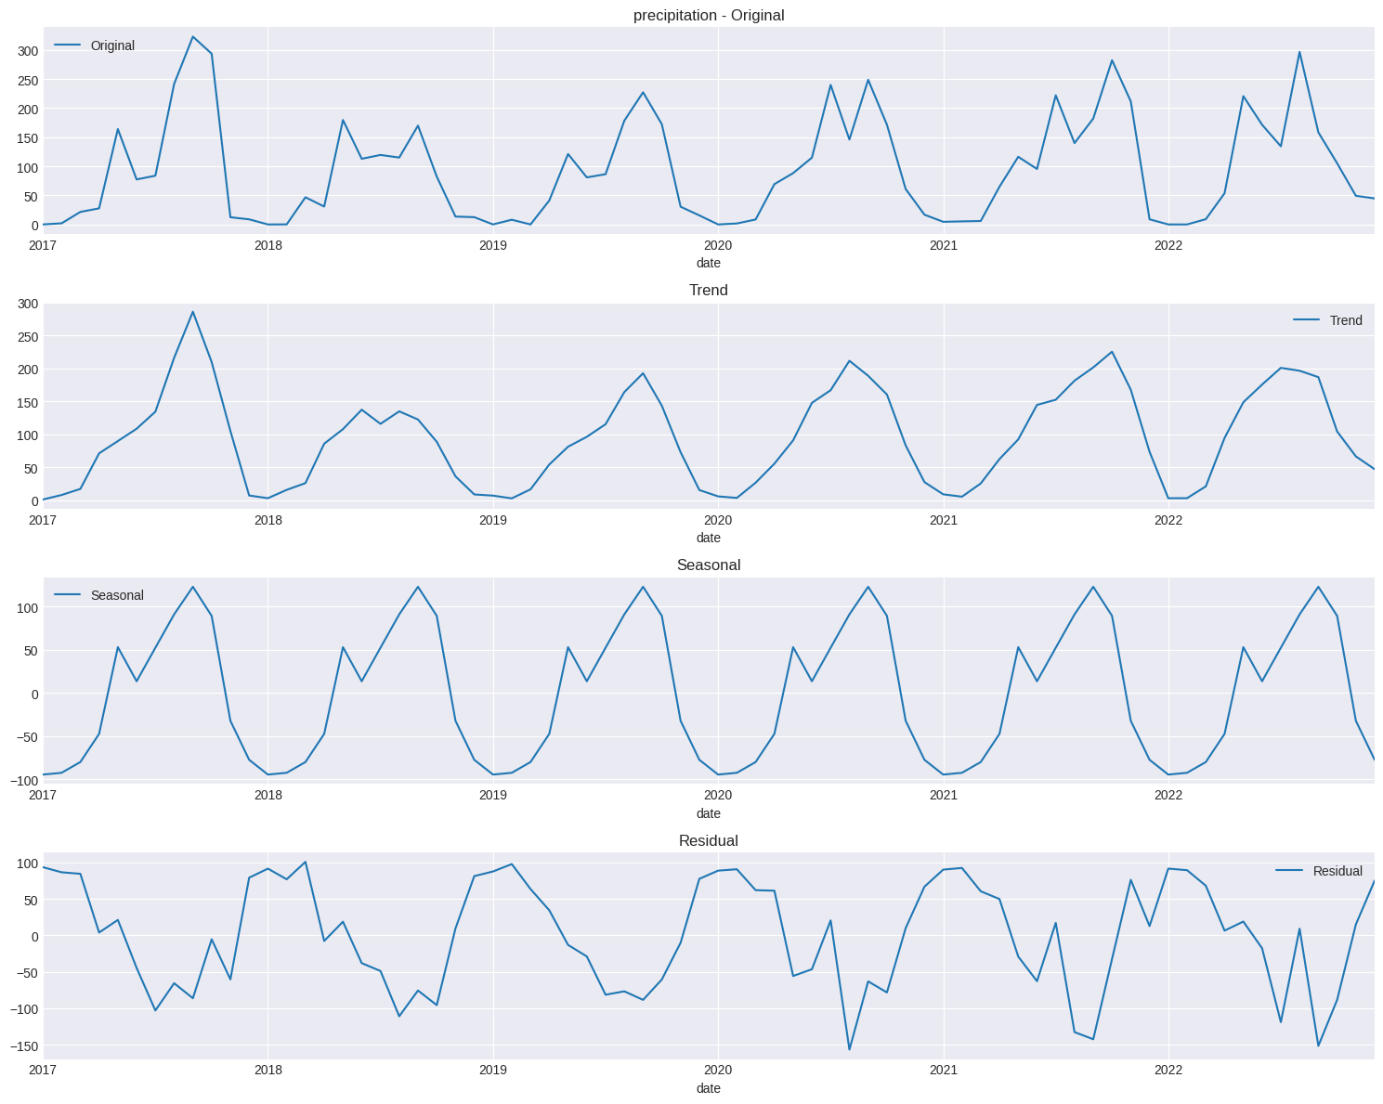
Trend & Seasonality Analysis :
(Precipitation) -->

Slide 16
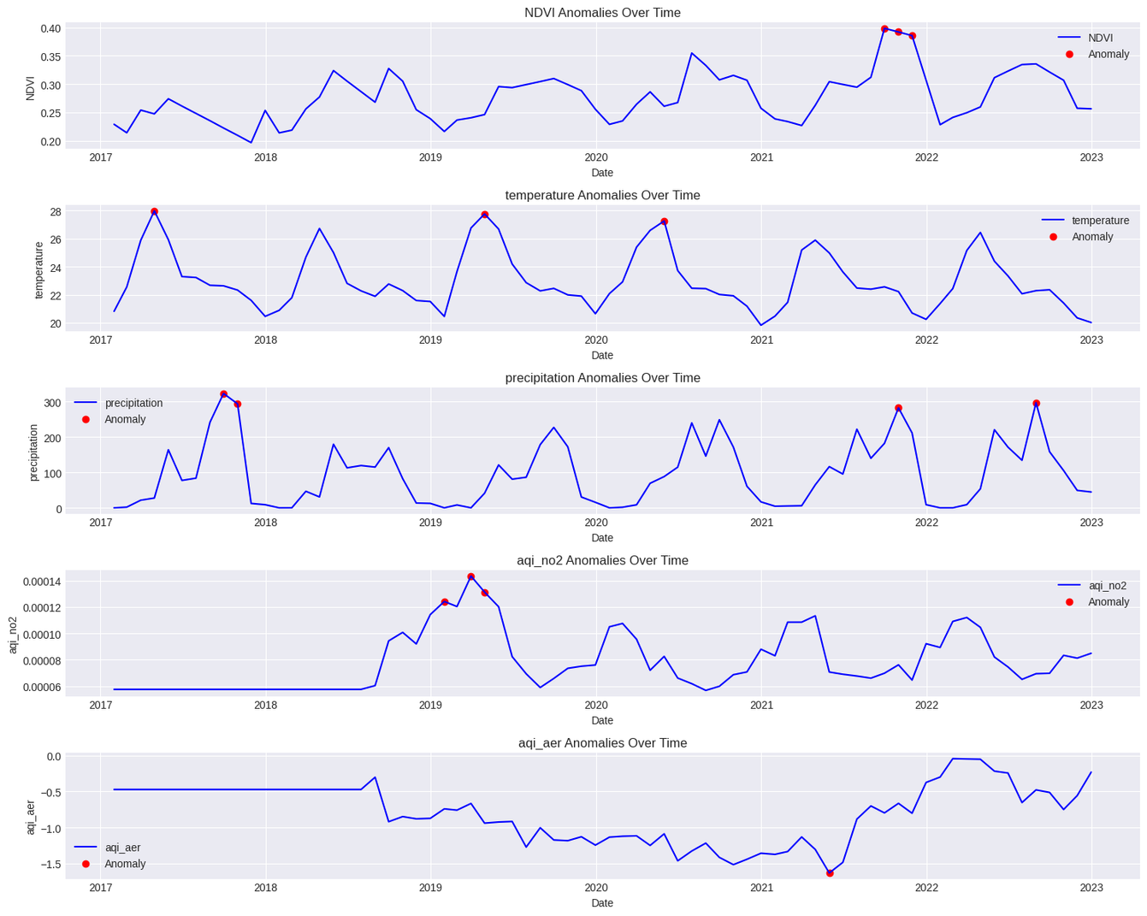
Exploratory Data Analysis (EDA)
Distribution & Anomaly Detection

Slide 17
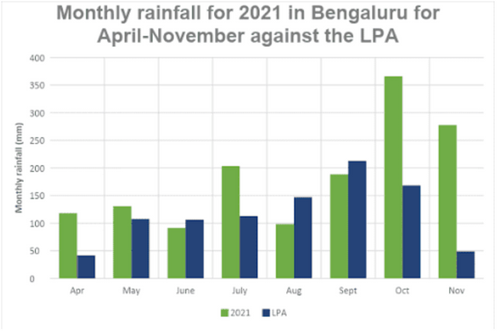
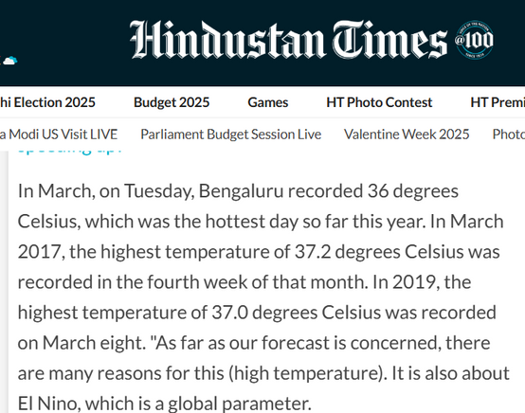


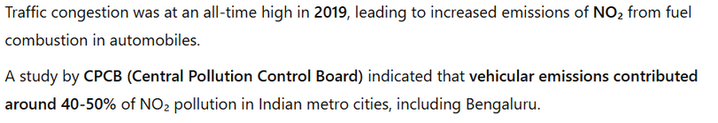
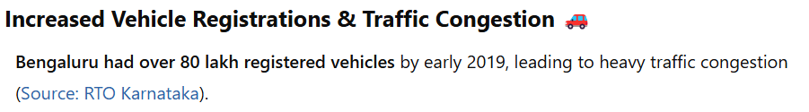
Case Study (why anamolies ?)
Precipitation (Rainfall):
Temperature:
NDVI:
Reference
Reference
Reference
then where all vehicles gone after 2019 ?:
NO2 concentration:
Reference
Reference

Slide 18
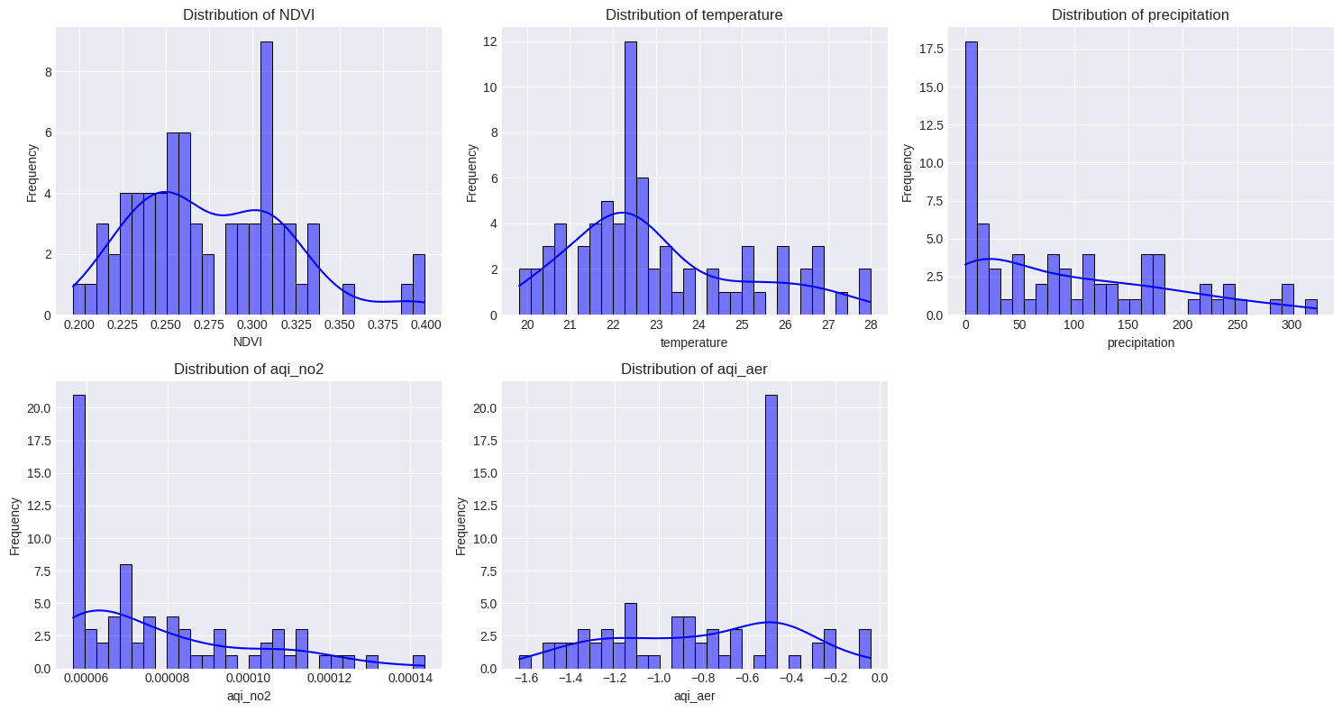
Histogram :
Shows the frequency distribution of variables (e.g., NDVI, temperature).
Helps in understanding normal vs. extreme values.

Slide 19
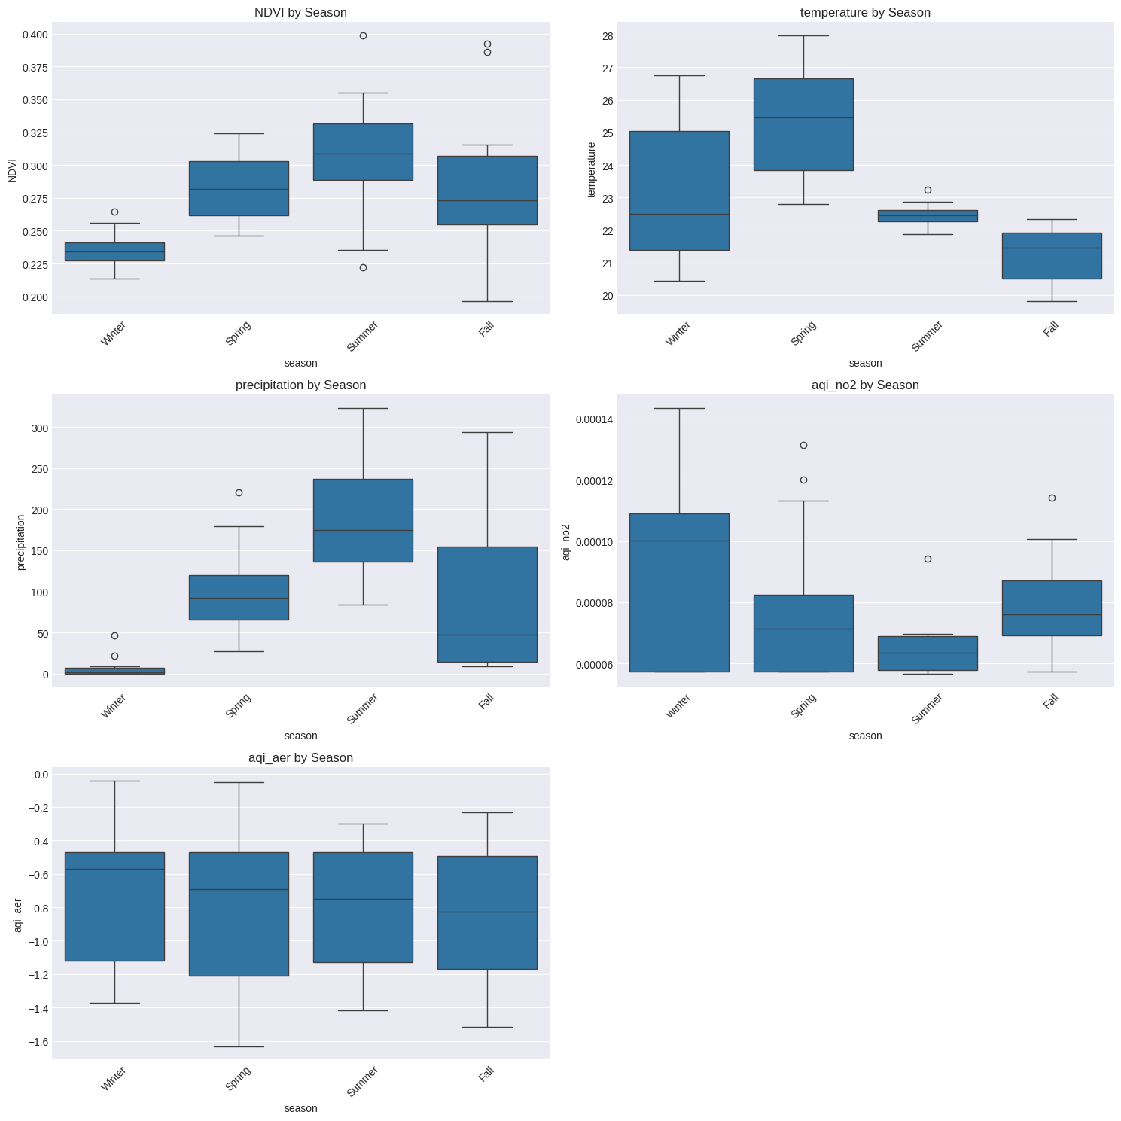
Box plots to analyse the seasonal variations

Slide 20
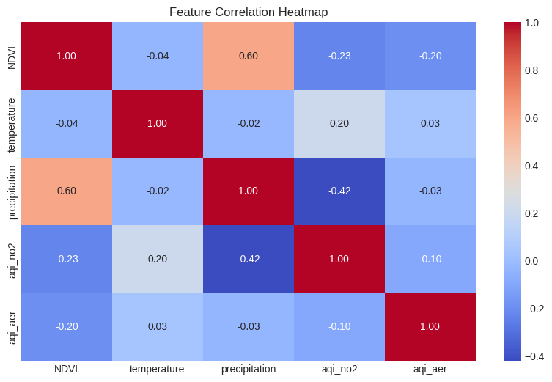
Exploratory Data Analysis (EDA)
Correlation & Relationships
NDVI & Precipitation → 0.60 (Moderate Positive Correlation)
🌱 Why? More rainfall usually increases vegetation growth (higher NDVI).
Precipitation & AQI (NO₂) → -0.42 (Negative Correlation)
🌧 Why? Rain helps clean pollutants from the air, lowering NO₂ levels.

Slide 21
Model Development & Forecasting
Traditional vs. Machine Learning Approaches :
Traditional Approaches: SARIMA/SARIMAX models use historical patterns for forecasting.
Machine Learning: Random Forest leverages feature engineering and non-linear relationships.
Hybrid Approach: Combining statistical and ML models can improve accuracy.

Slide 22
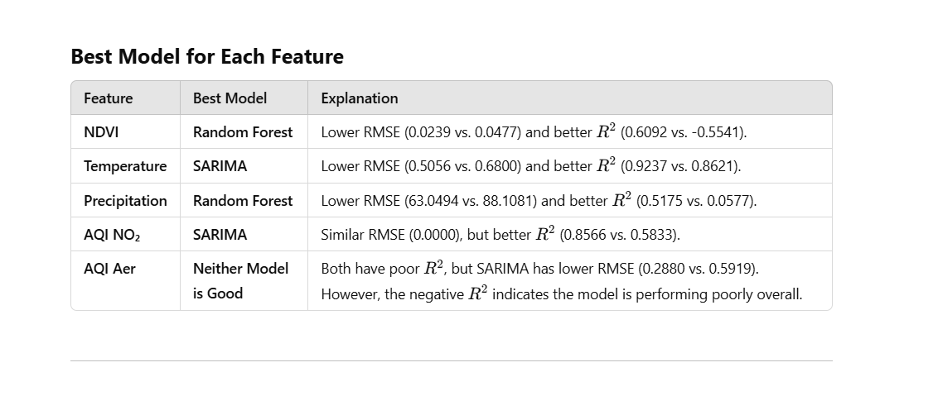
SARIMA Model / Random Forest
Interpretation of Metrics
RMSE (Lower is Better): Measures the average prediction error in the same unit as the target variable. A lower RMSE means better accuracy.
R^2 (Closer to 1 is Better): Measures how well the model explains variance in the data. A negative R^2 means the model is worse than a simple mean prediction.

Slide 23
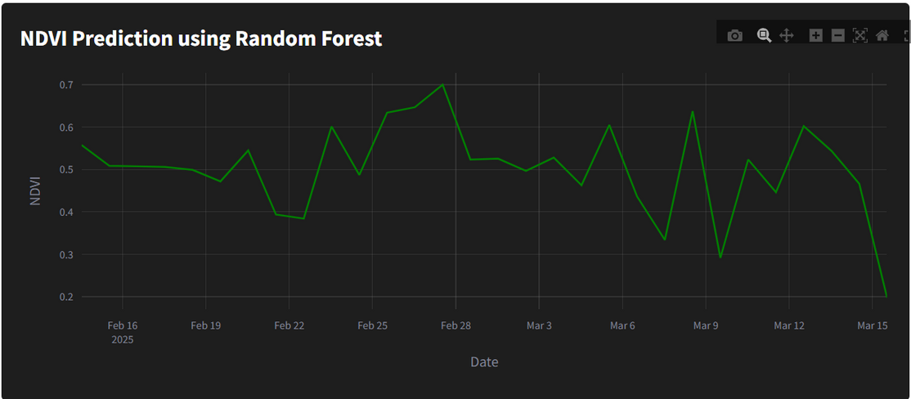
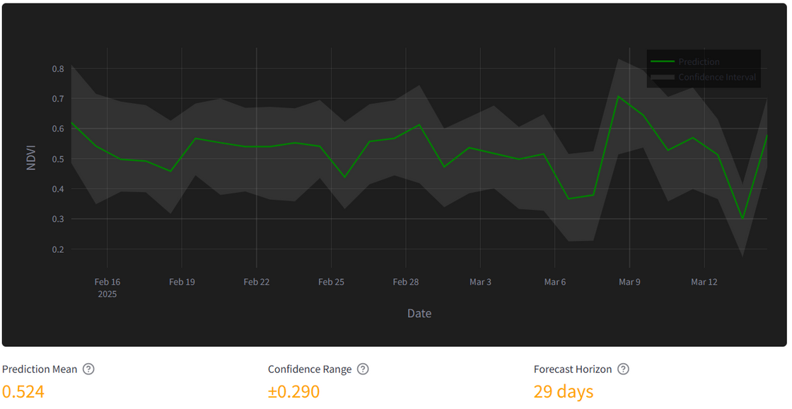
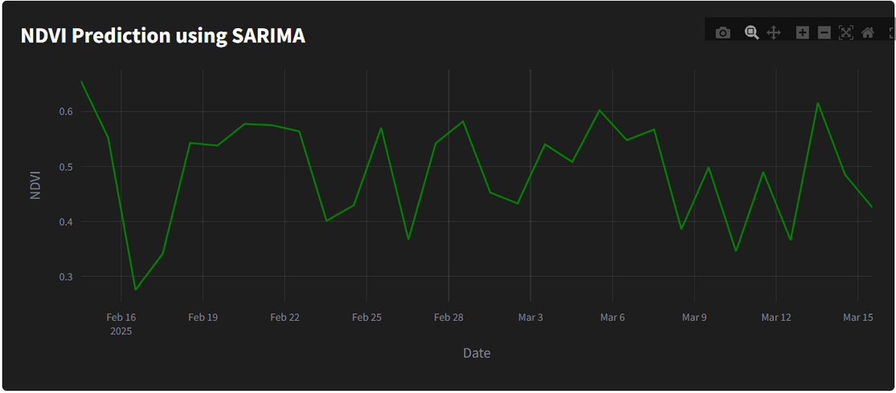
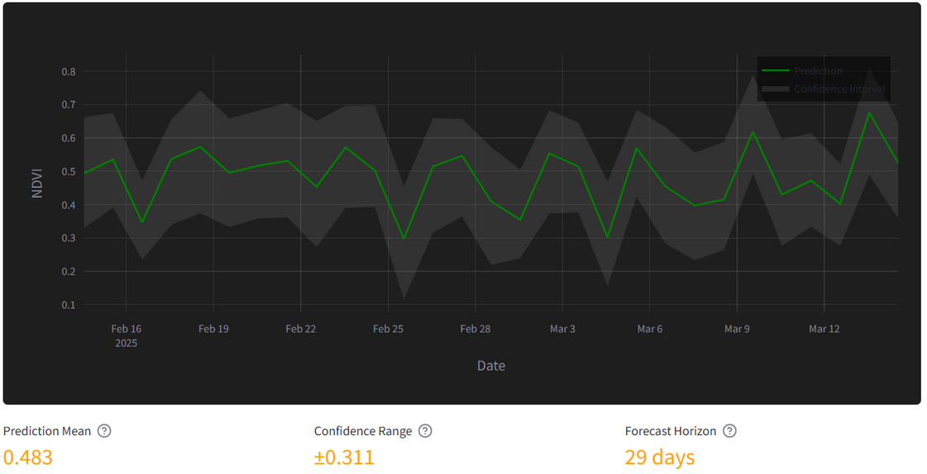
Visualizations:

Slide 24
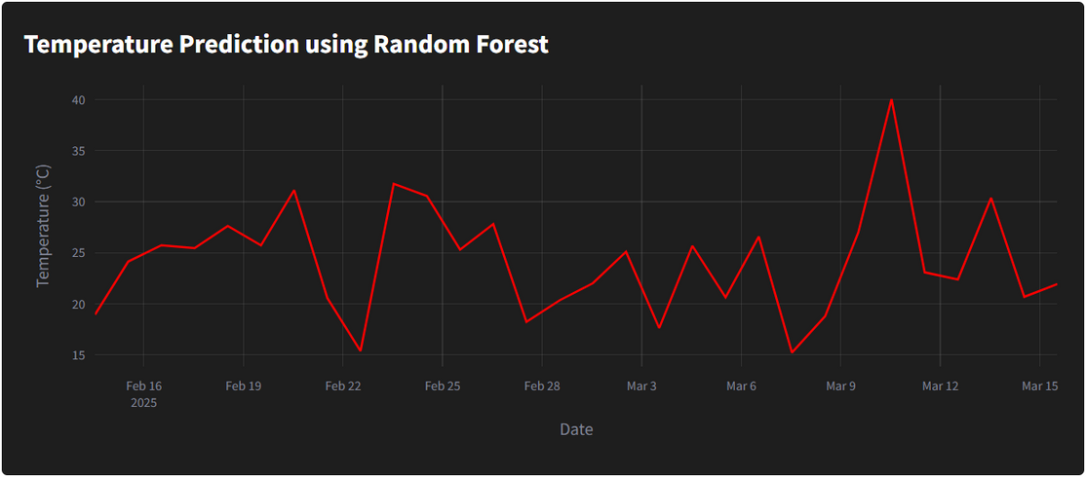
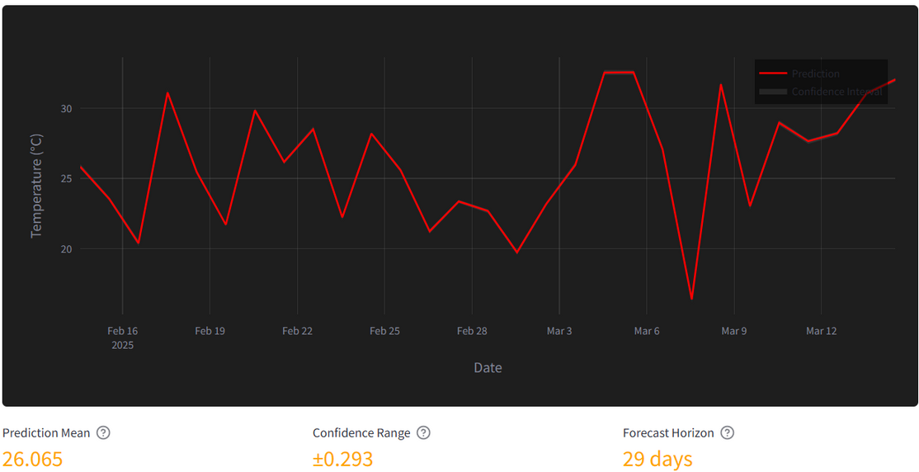
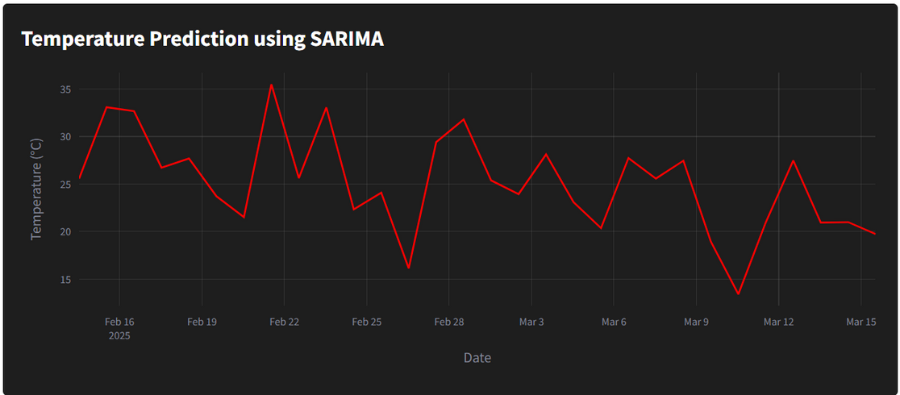
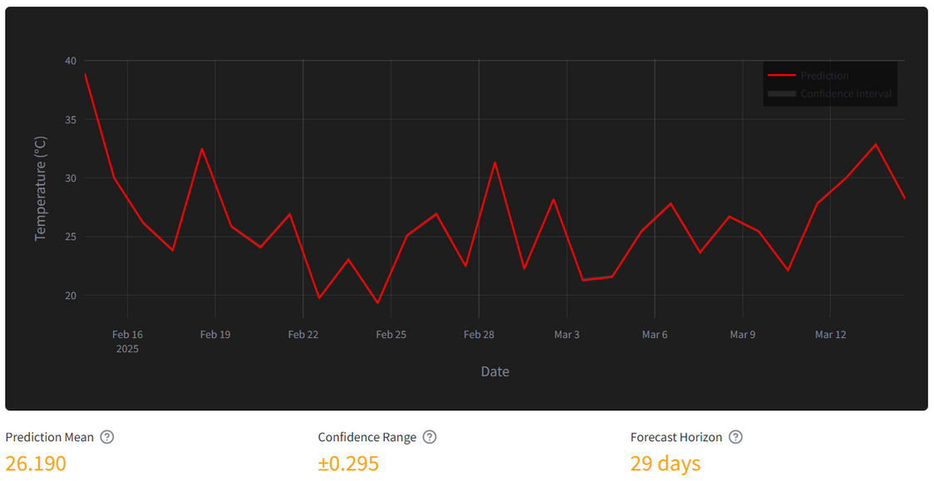
Visualizations:

Slide 25
Model Training & Validation
Data Splitting:
Training Set: 80%
Testing Set: 20%
Model Training:
Random Forest:
n_estimators=100, random_state=42
SARIMA:
order=(1, 1, 1), seasonal_order=(1, 1, 1, 12)
Model Evaluation:
Predicted values compared to actual test data.
Evaluation Metrics:
Root Mean Squared Error (RMSE): Measures prediction error.
R² Score: Explains model accuracy.

Slide 26
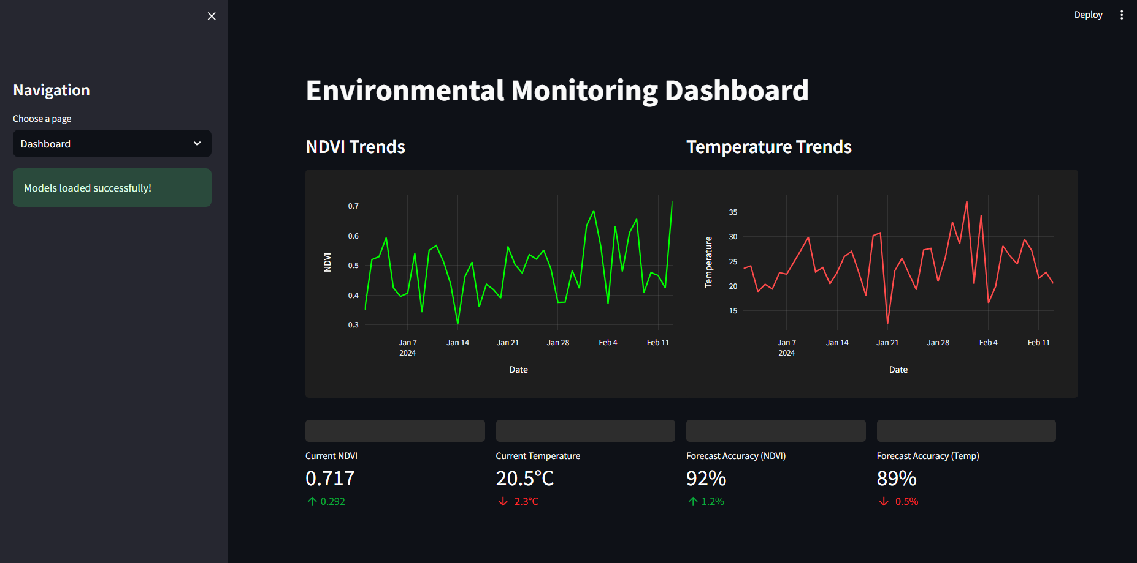
Dashboard Api

Slide 27
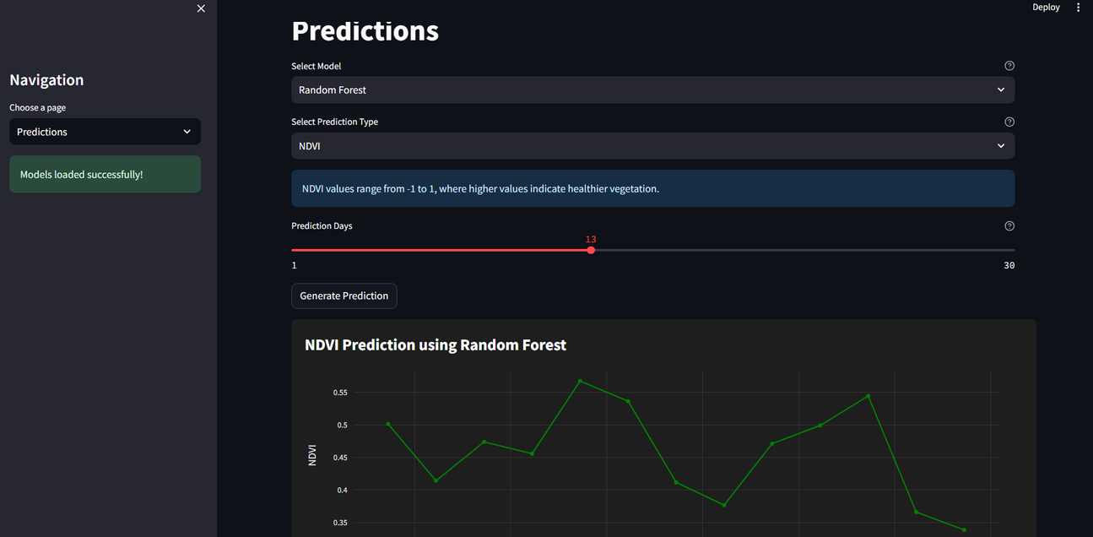
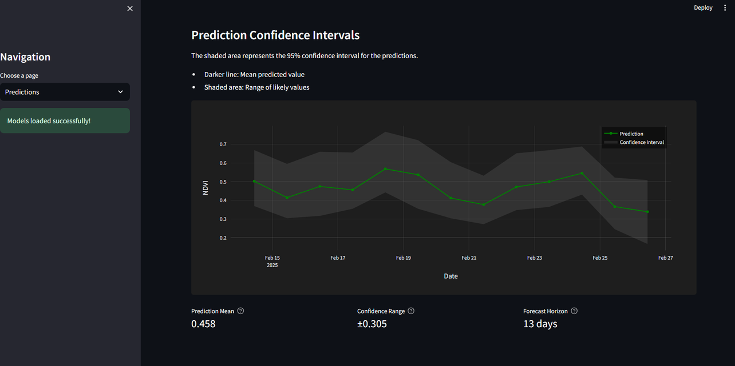
Prediction api

Slide 28
Impact & Sustainability
Urban Planning:
Guide sustainable growth through evidence-based policy.
Environmental Protection:
Mitigate air pollution by predicting hazardous levels.
Public Health:
Provide real-time information for residents, especially vulnerable groups.
Climate Change Adaptation:
Analyze the potential future impacts of climate change on air quality and vegetation.

Slide 29
Conclusion
“The project will provide valuable insights for urban sustainability in Bengaluru by forecasting key environmental parameters (AQI(NO2), NDVI, Rainfall & Temperature). The predictive models and will serve as tools for policymakers, urban planners, and the general public to take proactive actions for a healthier, greener Bengaluru.”

Slide 30


THANK YOU!

